Slide 1








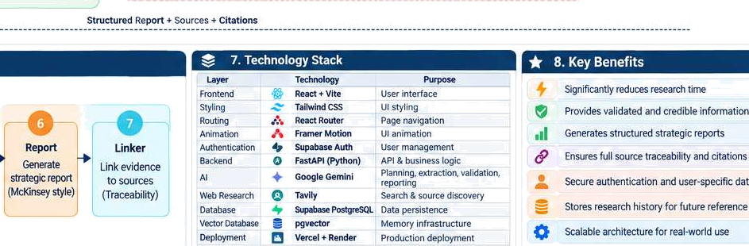
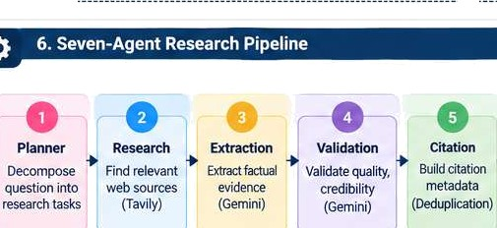
'
Project Over v 8 Sys tern Archit ec
1. Problem Stgtement
Market research is traditionally:
TJme-consuming
,Q
3. Ooe-dlnute Protest GpNnatlon
The McKinsey Ai Market Research Engine converts a user's research question in1o a nructured, evidence-backed strategic regort using specialized
M agems, web research. validation, citation mapping, persistent storage and an authenticated web interface.
An Al-powered multi-agent research engine that automates the end-to-end market research workflow.
ConveM a user's research quesgon into a strumured, evidence-backed strategic report. Uses specialized AI agents for planning, research, extraction, validation and reporting. Provides traceable citations and soume links. Saves research history with user authenticaiJon.
Designed with a McKinsey-style strategic analysis approach.
GG
Requires manual searching and analysis
Involves muhipie tools and sources
Difficult to validate source credibility
Challenging to organize findings
Needs domain expertise for strategic reporting
’
4. Project Objé dves
Consulting teams spend significant time collecting, validating and synthesizing information’ from.multiple soumes.
0
Backend
travel›
FastAPi
supabase
Submit Research Ouestion
View Repons Manage History
éuthentica‹ion
Report view
User Oata

Slide 2
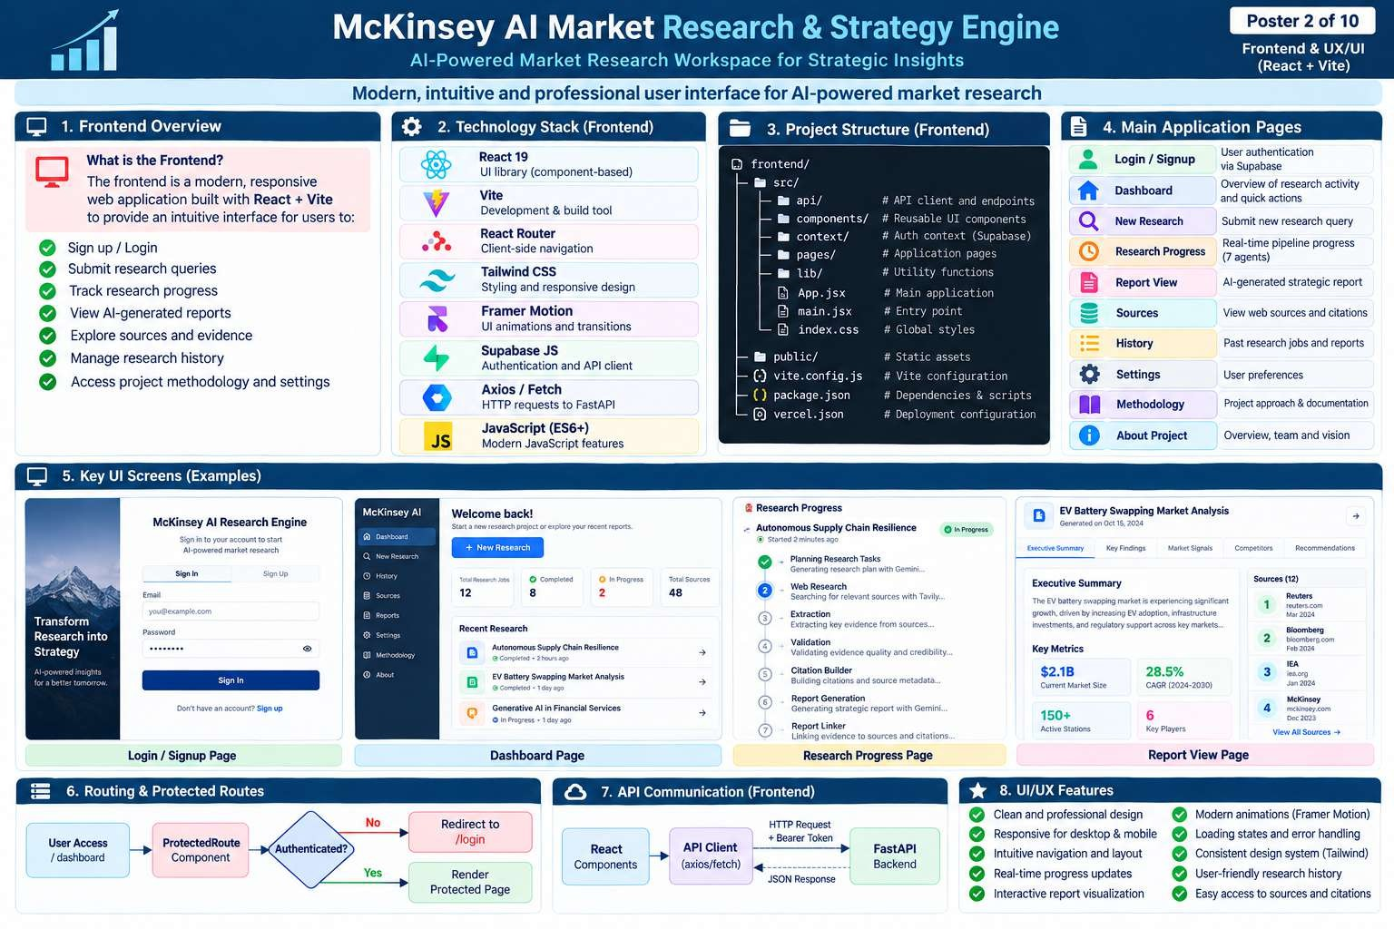

Slide 3
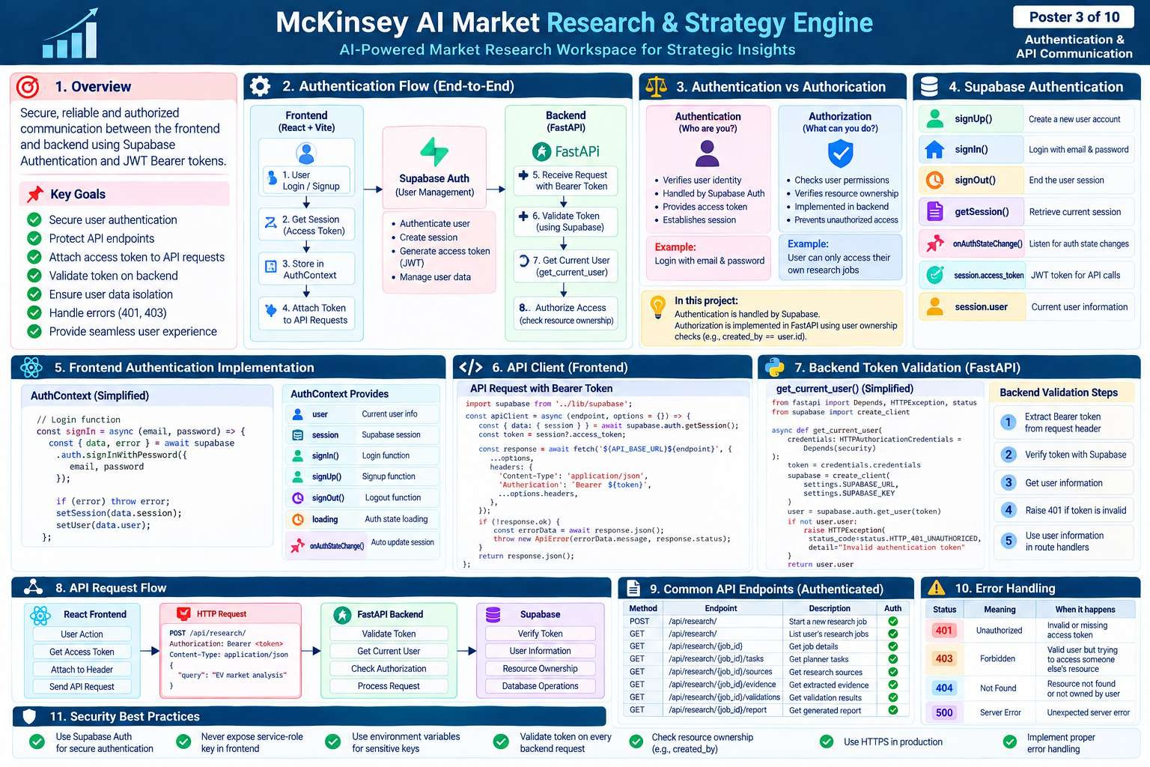

Slide 4
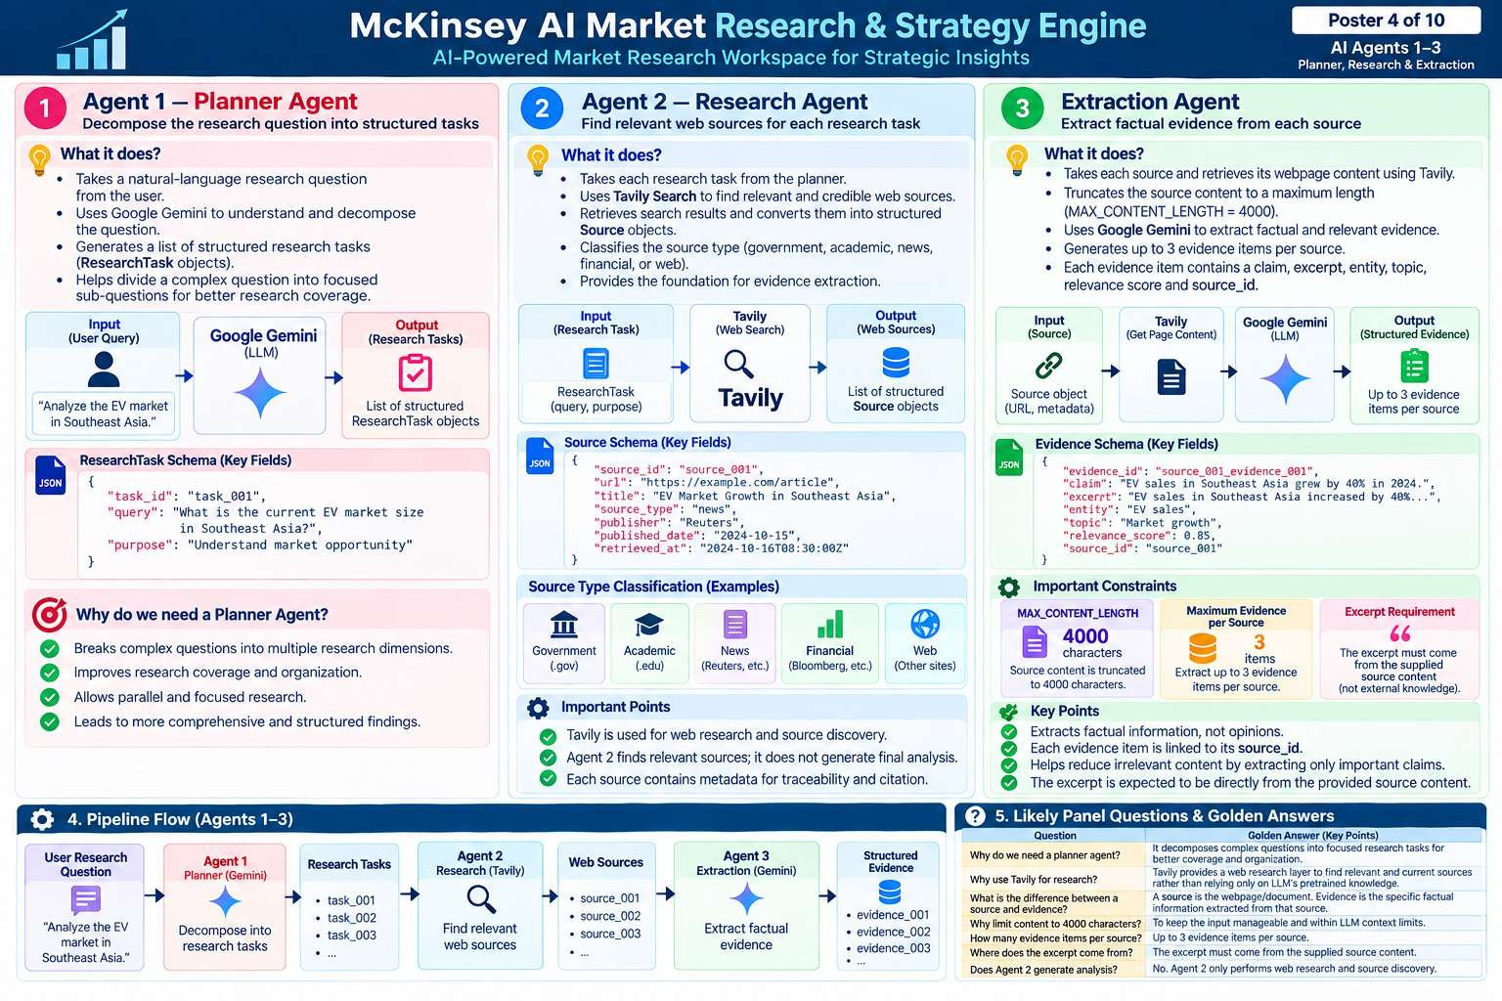

Slide 5
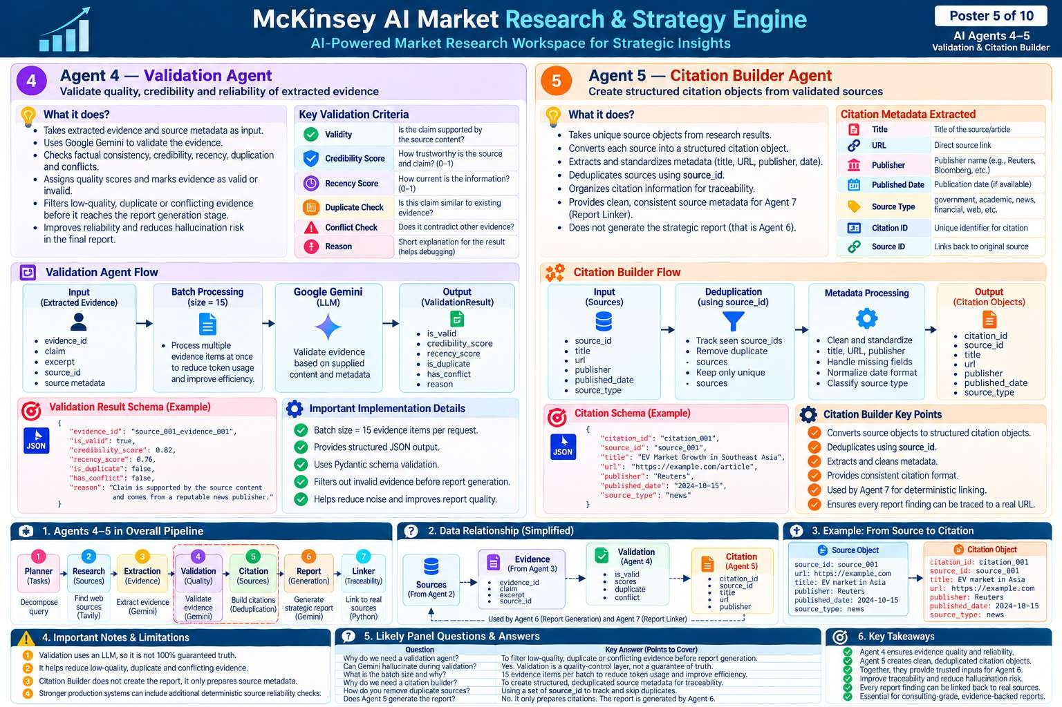

Slide 6
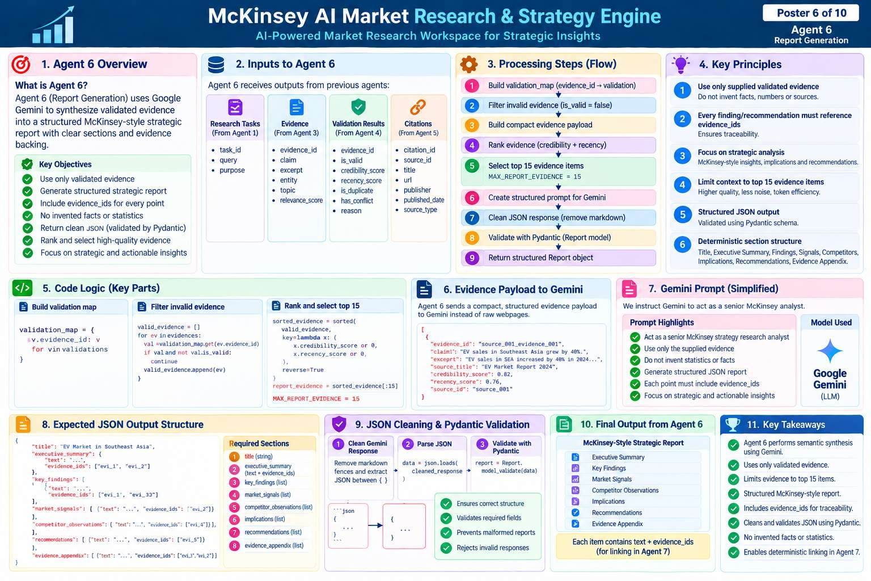

Slide 7
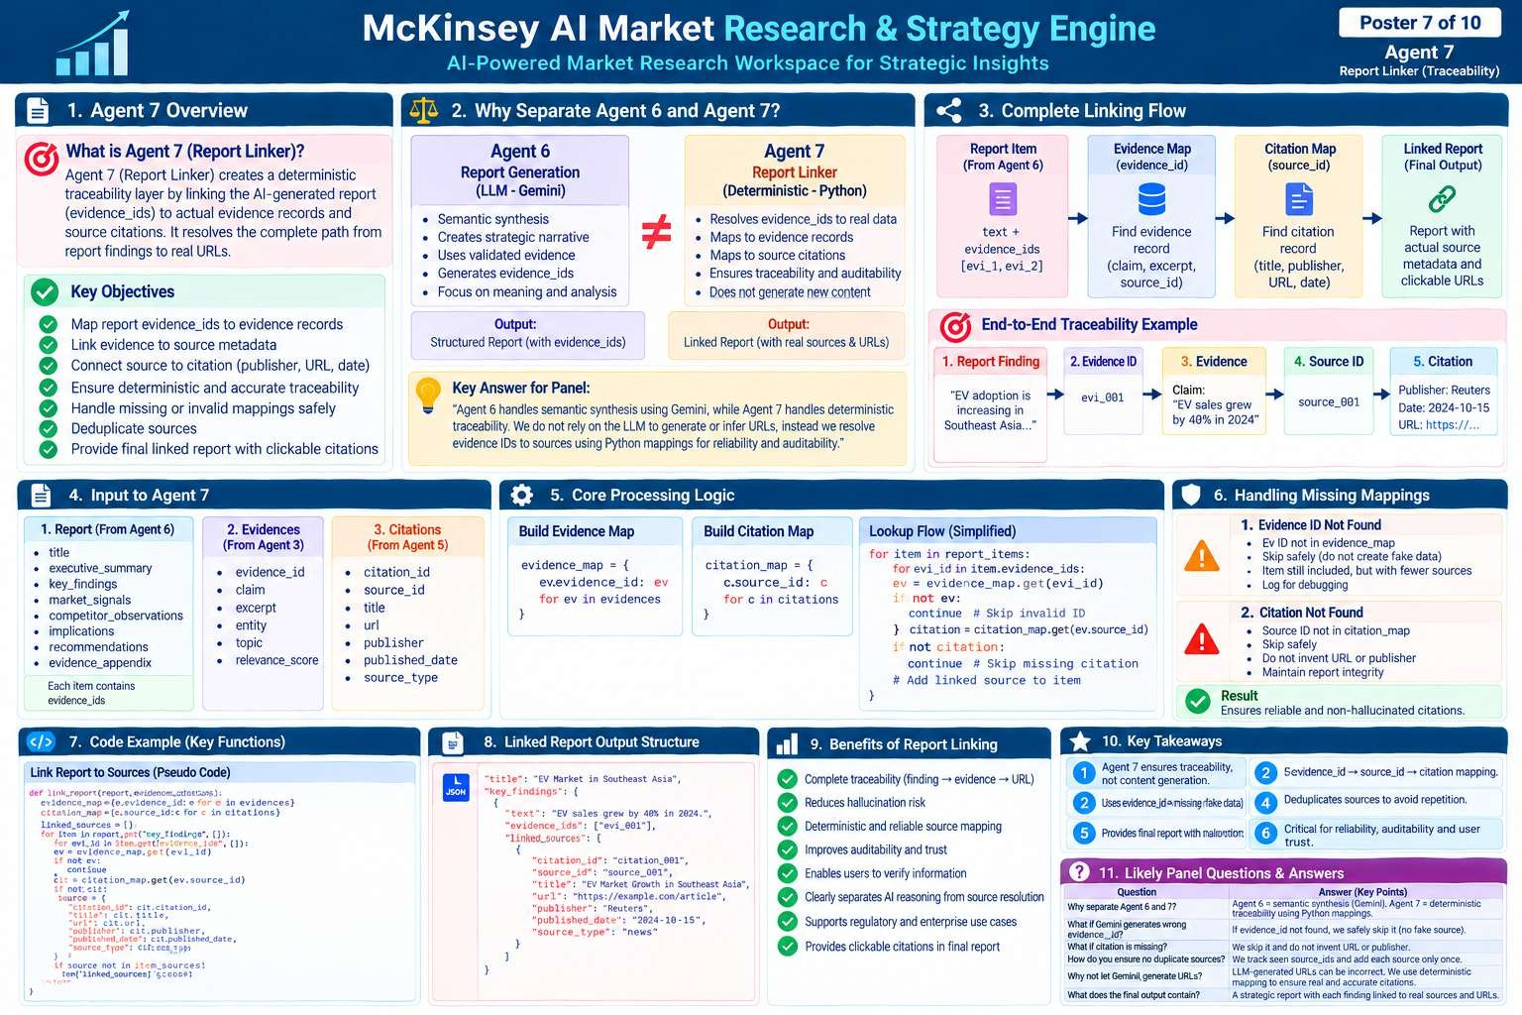

Slide 8
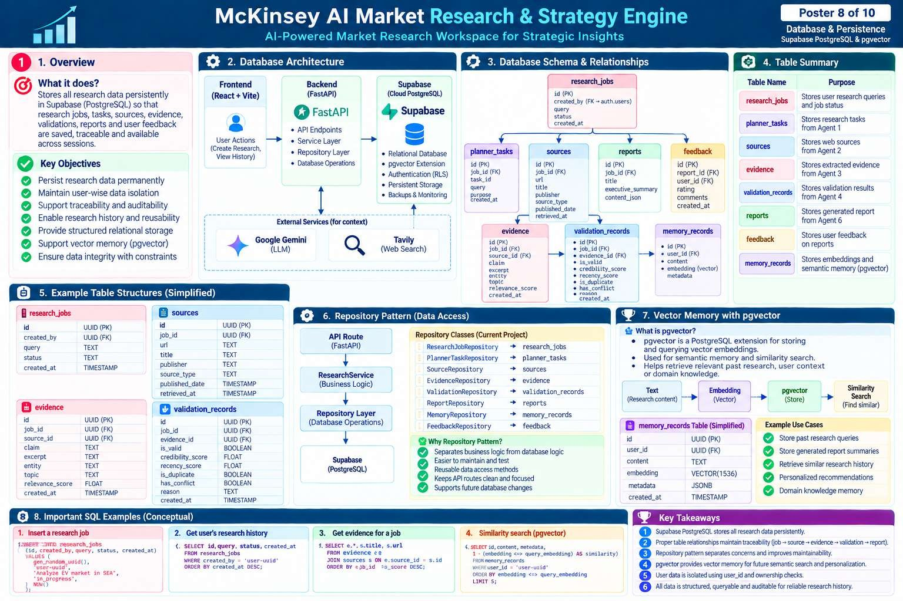

Slide 9
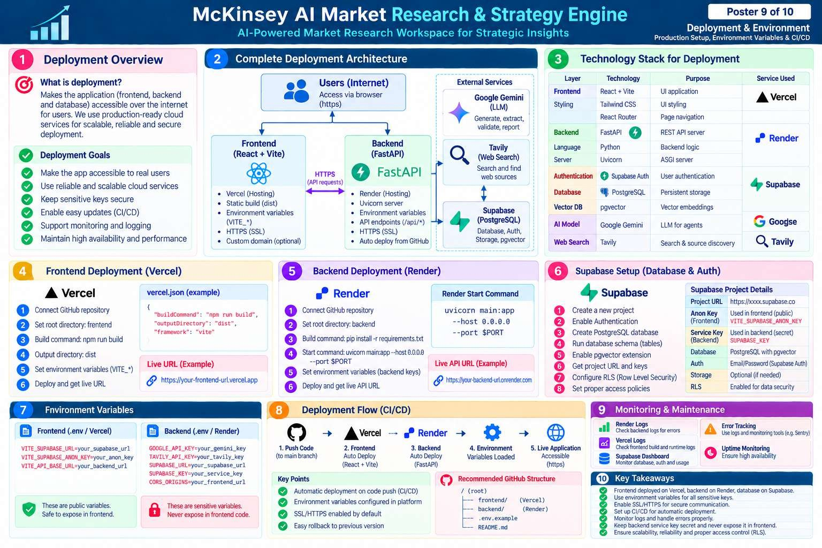

Slide 10
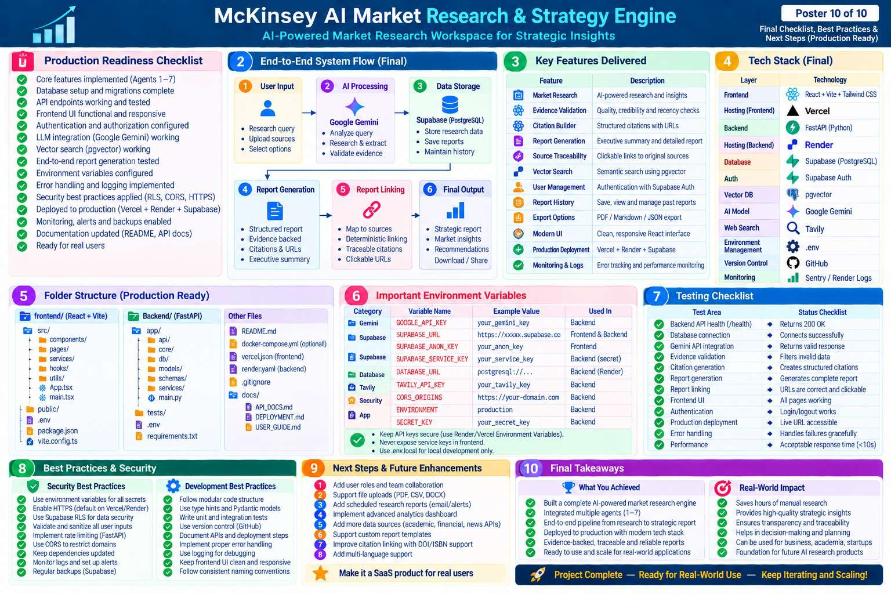

Slide 11
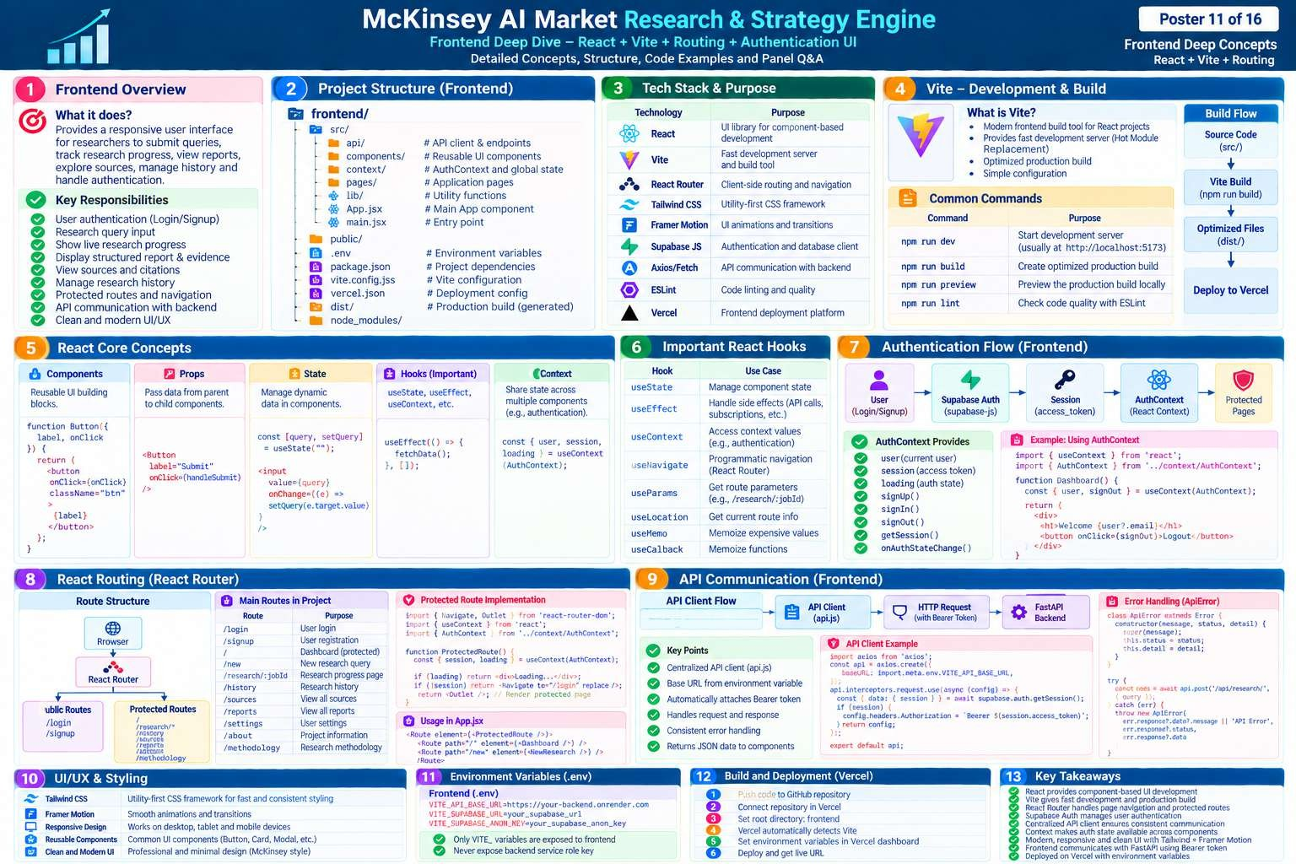

Slide 12
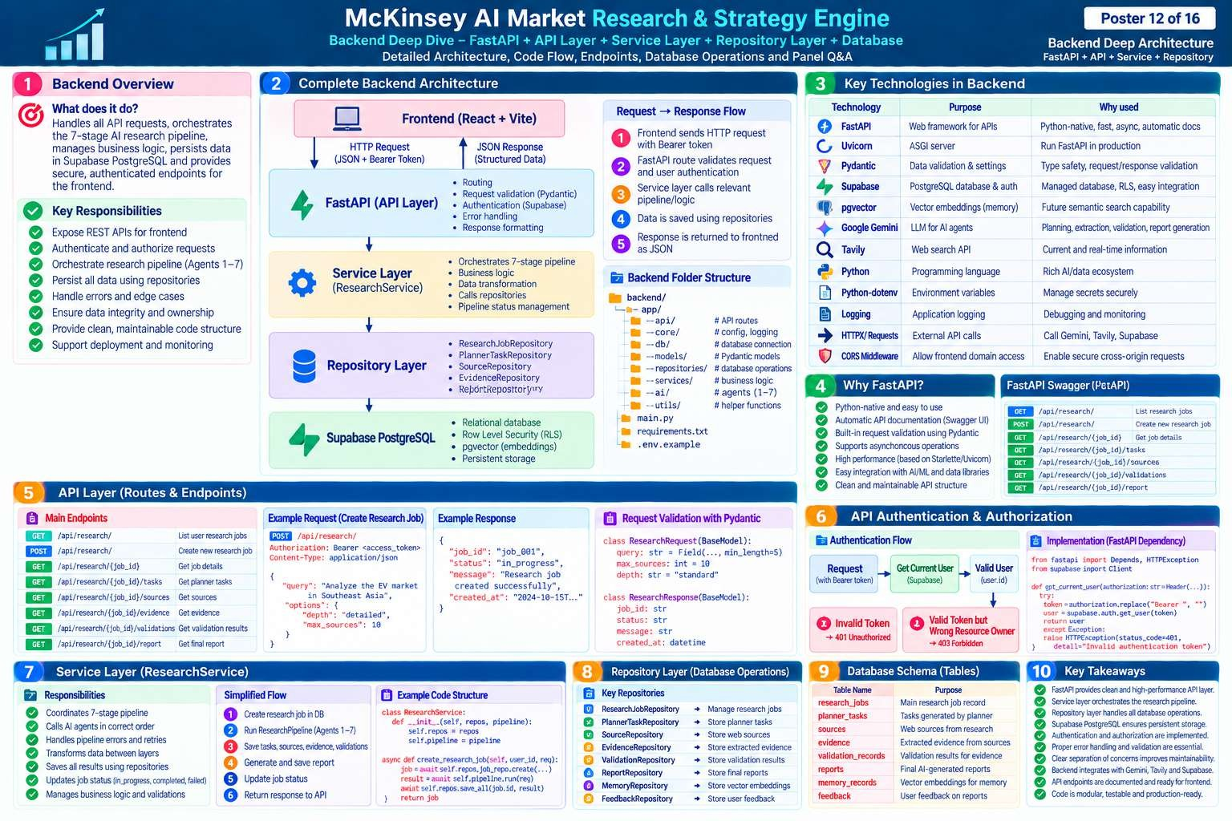

Slide 13
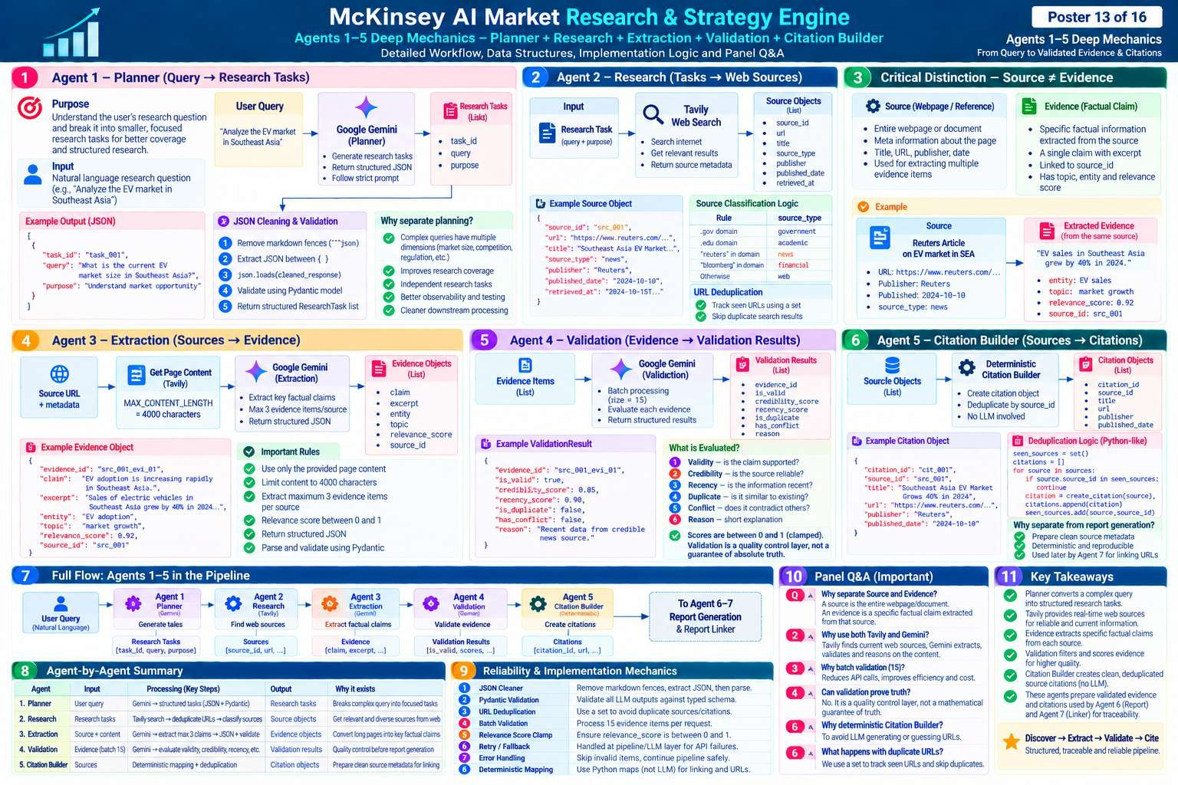

Slide 14
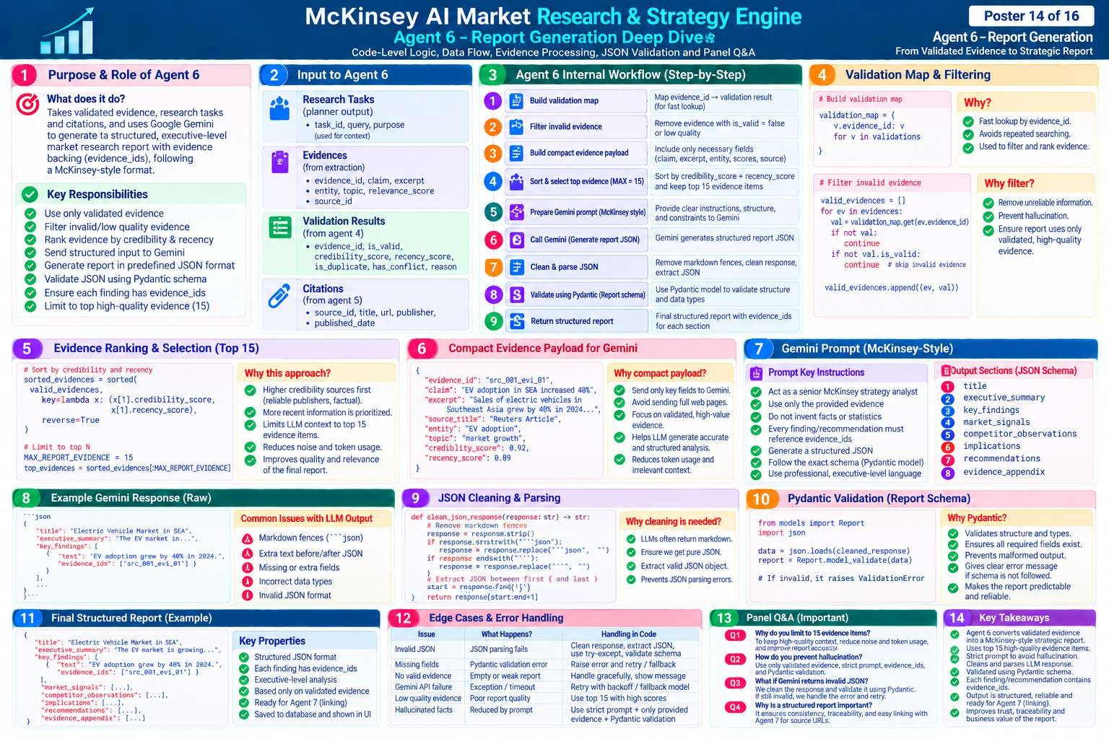

Slide 15
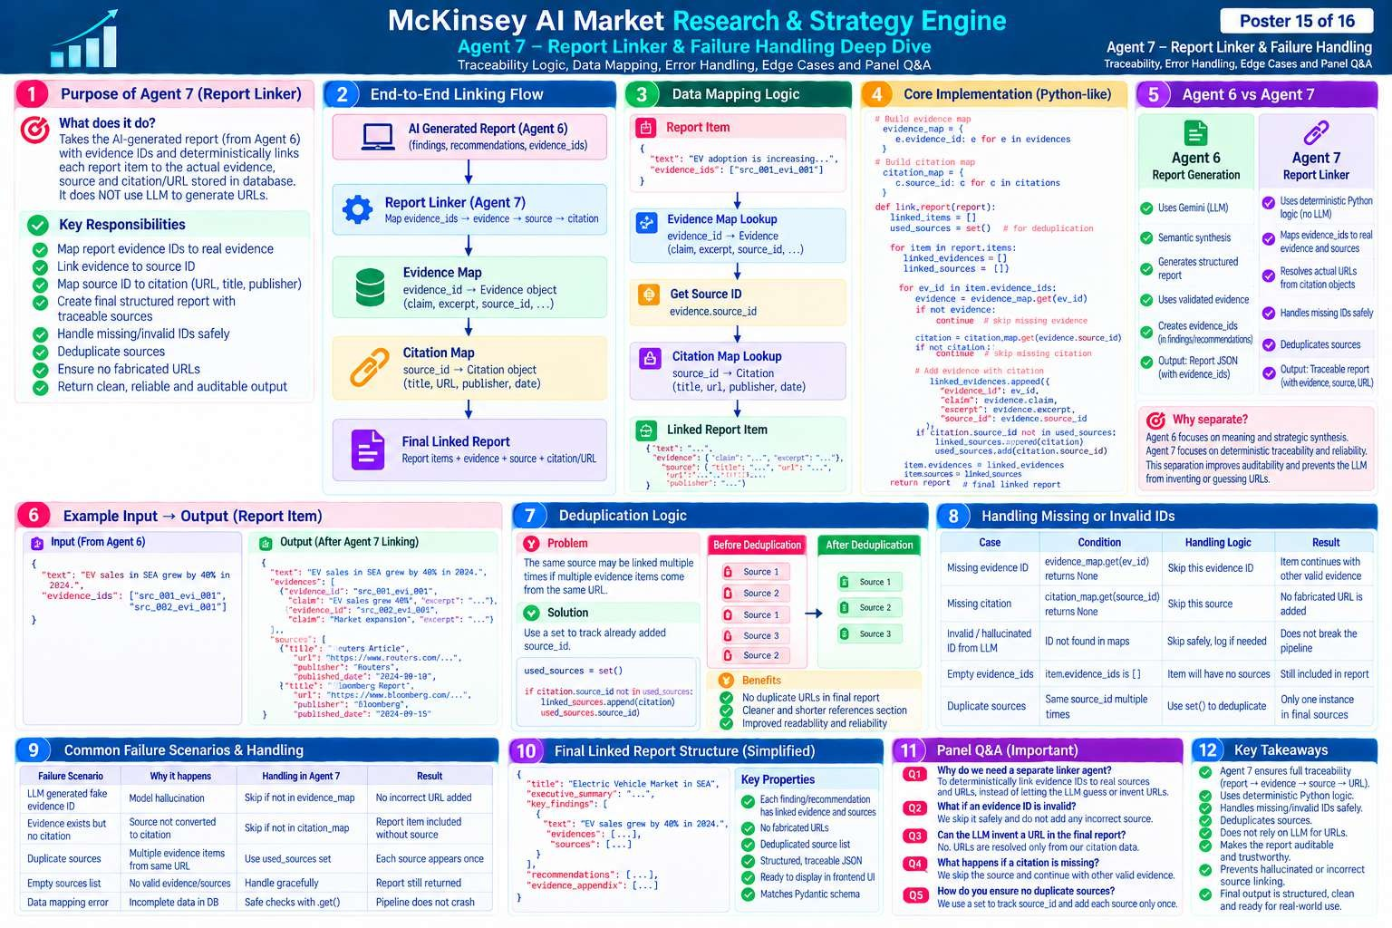

Slide 16
